Slide 1
UCAS: University Colleges Admission Services
Advice for Guidance Counsellors/ Advisers on completing the UCAS Application form.

Slide 2
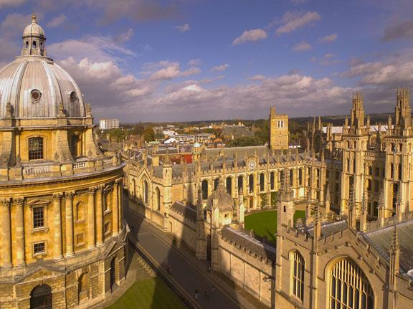
UK Universities
There are 325 Universities/Colleges throughout England, Scotland, Wales and N. Ireland
There are over 50,000 courses available
Each University has their own website all available through www.ucas.com

Slide 3
Registering your school
For each academic year you will be sent a username and password.
When you log on you will be asked to generate a buzzword.
What is a buzzword?
  Each school, college or centre creates a unique buzzword which is used to identify applicants in your centre. When a student enters your buzzword during registration, it links their application to your centre so that you can write the reference and send the application to UCAS.

Slide 4
Establishing Yourself as a Centre
Email customerdatabase@ucas.ac.uk and UCAS will issue centre with a username and password
All centres, whether new or already registered, need to appoint at least one member to act as Apply Co-ordinator

Slide 5
Important Dates:
15th Oct0ber 2012
Deadline for receipt at UCAS of applications to Oxford or Cambridge, and all with choices for courses in medicine, dentistry, and veterinary medicine/science to reach UCAS.
15th January 2013
Deadline for receipt of applications at UCAS for all courses except those listed with a 15 October 2011 deadline and art and design courses with 24 March 2012 deadline. Go to Course Search to check application deadlines for courses.
24th March
Deadline for the receipt of applications at UCAS for art and design courses except those listed with a 15 January 2012 deadline. Go to Course Search to check application deadlines for courses.
31st March 2013
If we receive your application by 15 January, the universities and colleges should aim to have sent us their decisions by this date (but they can take longer).
9th May
If we receive all decisions from your universities/colleges by 31 March, you need to reply to any offers by this date (unless you live outside the EU or you are applying through Extra). If we don't receive your replies, we will decline your offers on your behalf.

Slide 6
UKCAT/BMAT/HPAT Ulster
UKCAT: Candidates intending to apply in 2011 for entry to a relevant course in a UKCAT University (26 Universities) in 2012 (or for deferred entry in 2013) are required to sit the UKCAT by the 7th October 2011 deadline. UKCAT Centres in Dublin; Galway; Killarney; Cork
BMAT: The BioMedical Admissions Test (BMAT) is a subject-specific admissions test taken by applicants to certain medicine, veterinary medicine and related courses at the institutions listed : University of Cambridge; Imperial College London; University of Oxford; Royal Veterinary College; UCL; University of Bristol
HPAT Ulster: The test is used in the selection process by the University of Ulster for entry into the following courses:
BSc Hons Dietetics
BSc Hons Occupational Therapy
BSc Hons Physiotherapy
BSc Hons Podiatry
BSc Hons Radiography (Diagnostic)
BSc Hons Radiography (Therapeutic)
BSc Hons Speech & Language Therapy
The 2012 sitting of the test will be held on Saturday 28 January 2012. There is only one sitting each year

Slide 7
Other members of staff and UCAS
Can other members of staff be set up as users, referees or co-coordinators?
Yes.
Students may ask teachers other than the Guidance Counsellor to complete their reference.
Guidance Counsellors can facilitate teachers with a Username and Password when logging on to apply for the first time in each academic year.
When students complete the relevant sections they can then send it to their referee who can complete the reference in their own time.
The Guidance Counsellor can view the application at all times.

Slide 8
UCAS Terminology:
Apply: the online application system for applying for higher education courses. Apply and its supporting information can be accessed here.
Adjustment: applicants who have met and exceeded the conditions of their firm choice are given an opportunity to look for an alternative place while holding their original confirmed place.
Clearing: a system used towards the end of the academic cycle. If you have not secured a place, it enables you to apply for course vacancies.
Conditional offer: an offer made by a university or college, whereby you must fulfil certain criteria before you can be accepted on the relevant course.
Firm offer: the offer that you have accepted as your first choice.
Insurance offer: the offer that you have accepted as your second choice, in case you do not meet the requirements for your firm offer.
Personal ID: a 10-digit individual number assigned to you when you register to use Apply. It is printed on every letter we send you and is displayed in the format 123-456-7890. You will be asked to provide this number if you contact our Customer Service Unit.
Unsuccessful: you have not been accepted by the university or college concerned.
Confirmation: when conditional offers that you have accepted become unconditional or are declined. Confirmation is dependent on your qualification/exam results.
Deferral: holding an offer until the following year.
Entry Profiles: comprehensive information about individual courses and institutions, including statistics and entry requirements. Entry Profiles are found on Course Search.
Extra: the opportunity to apply for another course if you have used all five choices and not secured a place. Extra runs from the end of February until the end of June.
Point of entry: your year of entry to the course, for example, 2 refers to the second year of the course.
Track: a system where you can track the progress of your application online, reply to any offers received, and make certain amendments, for example, change of address or email.
Unconditional offer: an offer given to you by a university or college if you have satisfied the criteria and can attend the course.
Withdrawal: either you or a university/college cancels a choice before a decision has been made - a reason will be included if the withdrawal was issued by an institution.

Slide 9
Choosing a Course / Choosing a University
Once students have registered they should think about the courses/
universities they would like to consider
COURSE SEARCH

Slide 10
Which Course? Making Your Choice
As there are so many courses and universities to choose from students may feel a little overwhelmed. The Stamford Test allows students to narrow down their choices.
Taking the Stamford Test !
It asks students to answer ‘yes’, ‘no’ or ‘possibly’ to short series of questions. It then gives them a pointer to subjects that might be worth looking into
(Available on www.ucas.com)

Slide 11
Which Course? Making a choice
Where to go for help and advice?
The internet: Every University has a website with details of the courses available/ entry requirements etc.
Click on Entry Profile and Other Tariff Qualifications to find out what Irish Leaving Certificate Requirements are needed
UCAS website: www.ucas.com

Slide 12
Researching the courses of your choice
Compile a list of courses you would like to consider.
Read the Entry Profile of each course this provides information;
The course
Specific Entry Requirements (See Other Tariff Qualifications)
Careers Possibilities
Fees
Bursaries
Accommodation

Slide 13
Example Entry Profile for Medicine in University of Aberdeen
Course Specific Requirements Degree Types
English, Welsh and Northern Irish Qualifications International Applicants
Scottish Qualifications Mature Applicants
Other Tariff Qualifications Opening Doors - Alternative Ways to Get Into University
Access & Supporting Qualifications Aim4Uni - Widening Access Initiative
Other Qualifications Part-time Study
Degree Details Part-time Education Programmes
What we can offer you
Curriculum Reform - Enhanced Learning University Sport
Support for Your Studies Financial Support
The Hub Students' Association
Study Abroad Our Information Guides
Accommodation Careers
Learning Resources Getting to the University
Application and Selection
Choosing Your Degree and Enhanced Study What if I miss the UCAS deadline for submission?
Admissions Policy - Ensuring Equality and Fairness Can I take a Gap Year?
Entry Requirements Do I have to take an Admissions Test?
What Happens Next?
What are our students saying about studying here?
The University of Aberdeen
Medicine
5 year full-time Degree
Entry Routes and Degree Information
What we can offer you
Application and Selection
What are our students saying about studying here?
About this institution
Fees, bursaries and financial support
Aberdeen -The University
Aberdeen - The City
Student Profiles Graduate and Parent Profiles
Fees, bursaries and financial support
Fees for home students Bursary and scholarship outline
Fees for EU students Bursary details
Fees for international students Links to further information

Slide 14
Other Tariff Qualifications:
Irish Leaving Certificate
Subjects and grades required AAAAAA at higher level obtained at a single sitting. Chemistry is required plus two from Biology, Mathematics and Physics.
Additional Information All applicants will be expected to have taken the UK Clinical Aptitude Test (UKCAT)

Slide 15
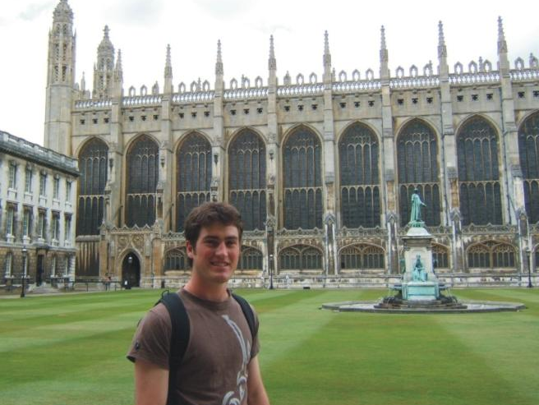
Which University?
Factors to consider
www.unistats.direct.gov.uk
Unistats: a website for students who want to research and compare subjects and universities before deciding where to apply. You can also look at student satisfaction ratings and explore the figures about getting a graduate job after completing a course. Visit the Unistats website

Slide 16
Which University ? Factors worth considering
Where is it? City or Town? Is it too far away from home?
Are public transport links good?
Cost?
Good reputation for delivering good quality courses and facilities?
How big is the University?
What is the accommodation like?
How good is the level of student support?
How many Irish students are currently studying at the university?
What is the social life like?
What are the opportunities for part-time work?

Slide 17
Fees for 2012:
Domicile of Student | Location of Institution
 | England | Scotland | Wales | NI
England | Up to 9K | Up to 9K | Up to 9K | Up to 9K
Scotland | Up to 9K | No fee | Up to 9K | Up to 9K
Wales | Up to 9K | Up to 9K | Up to 9K | Up to 9K
NI | Up to 9K | Up to 9K | Up to 9K | Up to £3465.00
EU | Up to 9K | No fee | Up to 9K | Up to £3465.00
Other International | Variable | Variable | Variable | Variable

Slide 18
NHS Courses:
The following programmes are funded by the NHS and UK and EU students are not required to pay fees, subject to EU status:
Doctor/ Dentist
Chiropodist (including podiatrist)
Adult Nursing
Children's Nursing
Mental Health Nursing
Learning Disability Nursing
Dietetics
Midwifery
Physiotherapy
Speech and Language therapy
Audiologist
Radiography
Radiotherapy
Research Clinical Psychology
Occupational therapy
Dental hygienist/ or Dental Therapist

Slide 19
Now make a shortlist
Once students have researched the courses and universities they would like to apply to, they should put together a shortlist.
Draw up a list of five choices (except medicine dentistry and veterinary science, students are limited to four choices in these fields)
Universities will only receive the details of the course and courses that students have applied to within their institution.

Slide 20

Completing the form
Online: Log on to www.ucas.com
You have the choice of applying individually or through your school
If you are applying through the school get the buzzword from your Guidance Counsellor

Slide 21

Sections to be filled In
Personal details
5 Choices
Education History
Employment
Personal statement
Predicted Grades
Reference
Declaration
Pay and send

Slide 22
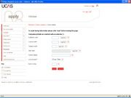
Choices Section
Five Choices
Each chosen course will have a code
Institution Code
The code can be found by clicking on course search
Point of Entry = 1
Campus = Main site

Slide 23
Your Personal Statement:
What interests you about your chosen course. Tell the universities and colleges why they should want you.
Include details of what you have read about the subject.
What career plans you have for when you complete your course.
Any job, work experience, placement or voluntary work you have done, particularly if it is relevant to your subject. You may want to include the skills and experience you have gained from these activities.
Any involvement in widening participation schemes such as summer schools or mentoring activities.
www.studential.com has example personal statements which are rated

Slide 24
Predicted Grades :
Must be obtained from each subject teacher
Universities use these as an indicator as to a candidates academic suitability for chosen courses
These grades should be accurate and based on what a candidate has the potential to achieve
If a candidate is applying individually they will need to ask their various teachers for written confirmation

Slide 25
Reference
Your referee should know you well enough to write about you and to comment on your suitability for higher education
The reference is a vital part of your application. UCAS cannot process the application without full details of a referee. References will not be accepted from family, other relatives or friends.
Once you have checked that your personal details, your choices, your education and employment details and your personal statement are all completed you can then send your application online to your referee. Before providing a reference, your referee may ask you to make amendments to the information you have provided. After providing a reference, your referee will approve your application and send it to us.

Slide 26
Completing the Reference:
Complete in MS Word first
Limited Number of Characters
Do not mention individual universities that the candidate have applied to as they may adversely affect their chances with non mentioned universities
If a candidate is applying to Oxford or Cambridge the thrust of the reference should be academic (75%)
Reference should allude to: Existing achievement;motivation and commitment towards the chosen course; any relevant skills, achievement accredited or not; powers of analysis and independent thought; relevant curriculum enrichment and other activities; relevant work experience; proposed career plan;

Slide 27
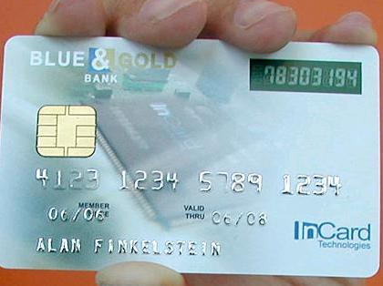
Application Fees:
If you have entered more than one choice in the courses section, your application fee is £22.00.You have to pay online by credit card

Slide 28
What happens when UCAS receive the application
When UCAS receive an application they send a copy to each of the chosen universities at the same time. The copy only shows the course(s) applied for at that particular university
Each university you have chosen will decide whether to make you an offer
Sometimes the applicant has to sit an admissions test or attend an interview, perhaps both depending on the popularity of the course
The university sends the decision to UCAS (not the applicant) and UCAS notify the applicant of that decision.

Slide 29
Offers: Two Types of offer
Conditional/ Unconditional
Conditional Offers
Unconditional offers
A conditional offer means that they will offer you a place if you meet certain conditions, which are usually based on your exams.
You may be asked to achieve specific Tariff points (e.g. 200 points from three A levels) or grades in named subjects (for example, B in chemistry, C in physics). You may also need to obtain specific grades in the individual units that make up these named subjects.
You must meet the conditions of your offer by 31 August (in the year that you apply)
An unconditional offer means that you have met all the entry requirements and the university or college is happy to accept you. The university or college will contact you if they need proof of your qualifications.

Slide 30
Irish Leaving Certificate Higher | Irish Leaving Certificate Ordinary | UCAS Tariff Points
A1 |  | 90
A2 |  | 77
B1 |  | 71
B2 |  | 64
B3 |  | 58
C1 |  | 52
C2 |  | 45
C3 | A1 | 39
D1 |  | 33
D2 | A2 | 26
D3 | B1 | 20
 | B2 | 14
 | B3 | 7

Slide 31
Accepting an offer
Replying to your offers
You must reply to each offer in one of the following ways.
Firm acceptance (F)
Insurance acceptance (I)
Decline (D)
Firm acceptance
If you firmly accept an offer, it means that this is your preferred choice out of all the offers you have received. As this is your first choice, you can only make this reply once.
If you accept an unconditional offer (UF), you are agreeing that you will attend the course at that university or college and must decline all other offers.
If you accept a conditional offer (CF), you are agreeing that you will attend the course at that university or college if you meet the conditions of the offer. You can accept another offer as an insurance choice.
Insurance acceptance
You can accept an offer as an insurance choice if your firm choice is conditional. Your insurance choice can be conditional (CI) or unconditional (UI) and acts as a back-up to your firm choice, so if you do not meet the conditions for your firm choice but meet the conditions for your insurance choice, you are committed to that course.
You do not have to make an insurance choice.
Decline
Once you have decided which offer to accept firmly, and which (if any) to accept as an insurance, you will may decline all other offers ,you will then become eligible for Extra or Clearing, depending upon your circumstances.

Slide 32
Contact Information:
www.ucas.com
Telephone: +44 (0)871 468 0 468
Rosehill
New Barn Lane
Cheltenham
Gloucestershire
GL52 3LZ

Slide 33
Useful Resources:
www.studential.com
www.unistats.direct.gov.uk
www.ucas.tv
http://hpat-ulster.acer.edu.au/
www.ukcat.ac.uk/
www.admissionstests.cambridgeassessment.org.uk/adt/bmat

