Slide 1
What is Work Experience
An introduction to the World of Work
Does not have to be a career path they are planning to continue with

Slide 2
Work Experience
It enhances their development
      Personal
      Social
      Vocational
      Educational

Slide 3
Learning Outcomes
Job seeking skills
Researching
Networking
IT skills
Application forms
CV's
Making phone calls
Presenting oneself

Slide 4
Learning Outcomes
An understanding of working life
Traveling to and from work
Timekeeping and punctuality
Following instructions
Meeting deadlines
Relating to supervisors
Dealing with customers
Working as part of a team
Health & safety practice

Slide 5
Learning Outcomes
Opportunity to develop transferable skills
Adaptability
Initiative
Independence
Motivation
Dependability
Professionalism
Develop a work ethic

Slide 6
Learning Outcomes
First- hand knowledge of Careers
The type of work involved
Skills and qualities required
Ups and downs of the job
Related career areas
Useful contact people

Slide 7
Finding a placement
Family
Friends
Relations
Neighbours
Drop-in/send email
Parents association
School - (last resort)

Slide 8
One of our TYs placement
Architects' Office 4 Fridays
Accountancy Firm 4 Fridays
Pharmacy 4 Fridays
Primary School 4 Fridays
DELL Course – Online
RCSI Mini Science Research Course - Online
RCSI Mini-Med Course - Online

Slide 9

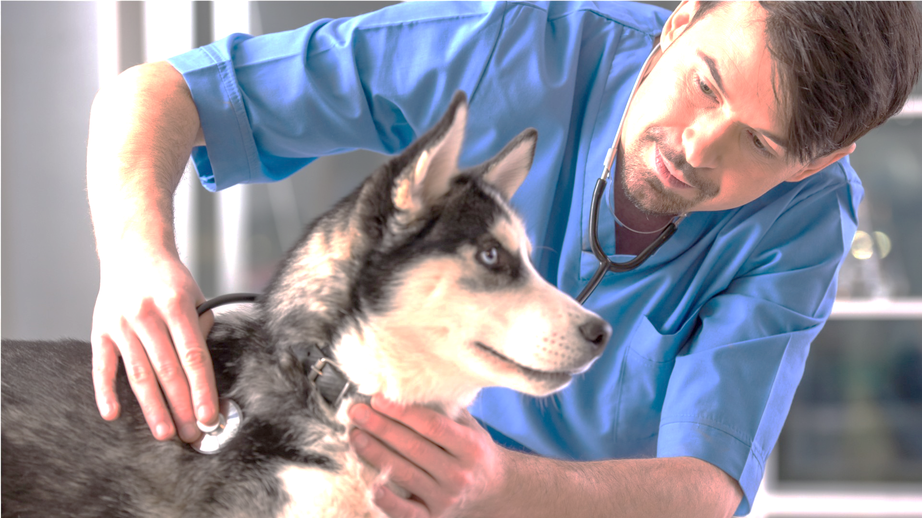
Transition Year Work Experience and Health and Safety
As we are aware some occupations by the nature of the work carried out and the surrounding environment are more dangerous than others.
Parents need to be satisfied that their child's placement is safe
Examples:
Construction
Veterinary
Farming

Slide 10
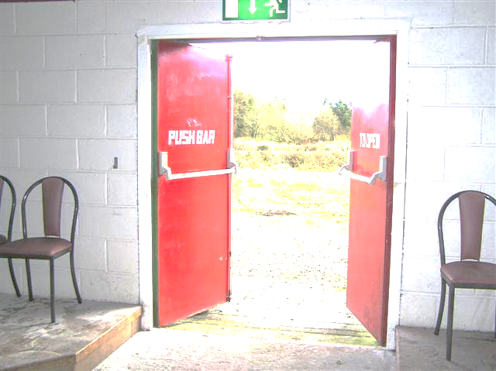
Students
Students should be aware of the health and safety issues associated with their place of work, and their responsibility within that work placement.
Example evacuation procedure, Fire assembly location.
Induction to work-place

Slide 11
Documents Required for placement
    Agreement form one for each placement (signed by student, parent, employer)
    Code of conduct
    Employers report
    Garda Vetting (for some only)

Slide 12
Documents for Employer
Letter from school
Work Placement summary sheet
Code of Conduct
Host Employers Guidelines
State Indemnity
Employers Report

Slide 13
Expectations
Time keeping
    You are responsible for getting to work on time
Presentation
    Neat dress
    Makeup / Earrings
    Use of Mobile phone
You are a guest (Socialization)
Your expectations of the work experience

Slide 14
Attendance
Work experience is a school-based activity attendance is mandatory
  Extra-curricular activities
  Appointments
  Please give notice of absence at the earliest possible time

Slide 15
During Placement
Daily Diary (5 minutes)
Class work on Work Experience
Communicate with students regarding placement
Self-Evaluation at the end of each Placement

Slide 16
Work experience debriefing
Letter of thanks
Work experience self-evaluation/reflection to be completed at the end of each placement
Employers Report
Parents Evaluation

