Slide 1
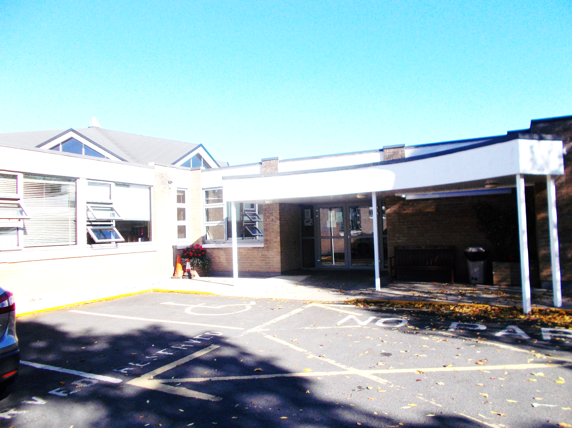
Crescent College Comprehensive S.J.
Meeting on Subject Choice for the
Traditional Leaving Certificate
Wednesday 24th March 2025
Guidance Counsellors;
Caroline Coughlan,
Ita Danaher,
Peter Moloney

Slide 2
The start of the Leaving Certificate

Slide 3

Why do the Leaving Certificate
  Achieve a formal level of education
  Used as a means to enter Third Level Education
  Meet a requirement for a particular career
    It a very crude method of short listing people for a career

Slide 4
For the last 2 points
Entry to3rd level Education
A Career
I am going to take a very crude straight forward approach here,
It’s a Competition

Slide 5
Why so important to maximise our points
Points achieved relative to CAO level 8 and level 7 courses
Total number of CAO courses 1717 level 8 & 7
Level 8 courses 1353
Level 7 courses 364
Points | Percentage
600 | 98%
550 | 95%
500 | 89%
450 | 82%
400 | 72%
350 | 67%
300 | 44%
250 | 31%
200 | 20%

Slide 6
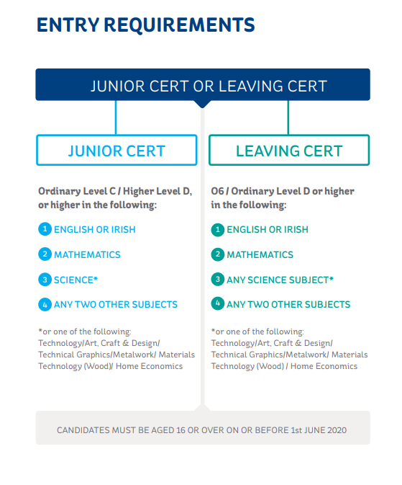
ESB Apprenticeship

Slide 7
Have a strategy
We need to identify our strengths and where possible work with these
What subjects should I do for the Leaving Certificate that will give me the highest grades/points
A very Simplistic Approach

Slide 8
Simplistic Approach
2 questions we need to ask ourselves
  What would I like to do?
  How do I get there?
  The answer to these 2 questions should help formulate one’s pathway in education

Slide 9
If I want to become an Electrician
  Need to do an apprenticeship
  What do I need to become an apprentice electrician?
  A Junior Certificate however, having a Leaving Certificate means I’m more competitive
    The better Leaving Certificate I have the more competitive I become

Slide 10
Apprenticeships
Apprenticeship.ie
Generation Apprenticeship

Slide 11
To become a Nurse
Need to go to 3rd level education
Need to apply for place on a nursing course through the CAO or in the UK (UCAS)
Need to ensure I am doing a Science Subject in my Leaving Certificate
Need to secure between 400 and 475 points in my Leaving Certificate

Slide 12
Going to College
Application through the CAO
To attend College /University
2 Requirements
The College Minimum Entry Requirement
Leaving Certificate Points

Slide 13

College Minimum Requirements
Generally there are 2 sets of ‘Entry Requirements’ which you must look out for before ‘points’ can be considered.
A) Minimum Entry Requirements
  A minimum no of honours/passes in the L.C. for example 2H5 and 4O6/H7
  Particular subjects example English and Maths
  English, Irish and Another Language (NUI colleges)
  English and another language

Slide 14
Minimum Entry Requirements of major CAO Colleges
Institution | Minimum grades | Required subjects
NUI Colleges: UCD, NUIM, NUIG, UCC. (RCSI, Shannon, Miltown) | 2H5 + 4O6/H7 | O6 in English, Irish & Modern Language*.
Trinity College Dublin | 3H5 + 3O6/H7 | O6 in Maths, English & another Language
Dublin City University | 2H5 + 4O6/H7 | O6 in Maths, English or Irish
University of Limerick | 2H5 + 4O6/H7 | O6 in Maths, English & Irish or another Language.
Technological University Dublin | 2H5 + 4O6/H7 | O6 in Maths, English or Irish
Technoligical Universities (Old Institutes of Technology) | 2H5 + 4O6/H7 | O6 in Maths, English or Irish

Slide 15

College Entry Requirements
B) Specific Course Requirements
  Specific subjects and/or levels required to gain entry to a particular course.
E.g. Veterinary Medicine in UCD
  Entry Requirements:
  2H5 + 4O6, O6 in English, Irish, Modern Language & Mathematics,
  H5 in Chemistry.

Slide 16
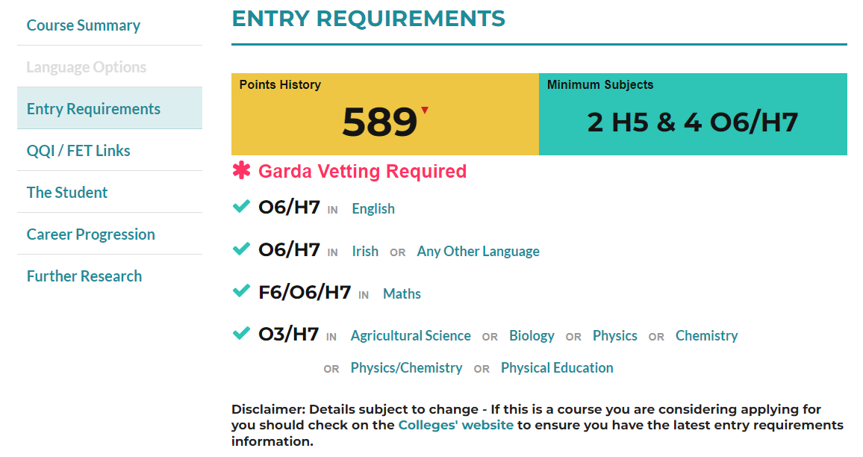
Physiotherapy in UL
Entry Requirement

Slide 17
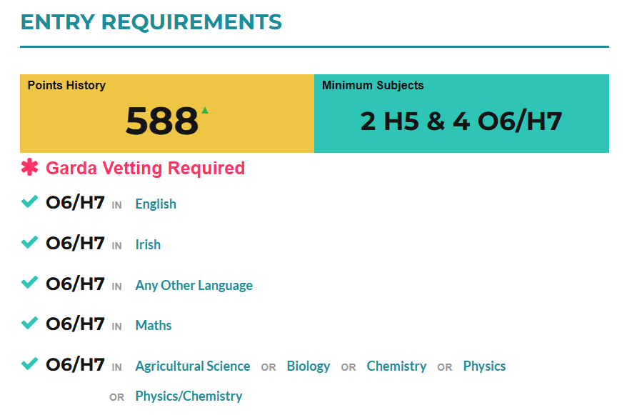
Physiotherapy in UCD
Entry Requirement

Slide 18
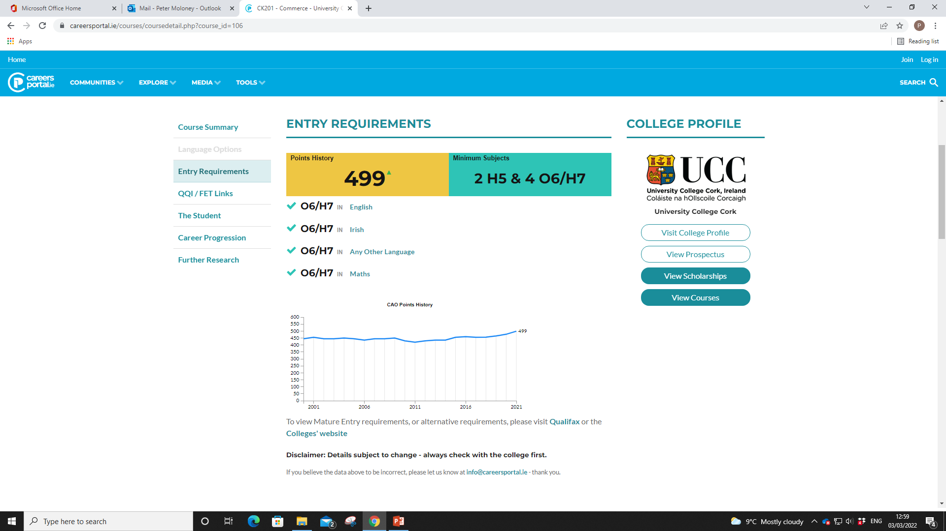
Commerce in UCC Entry Requirements

Slide 19
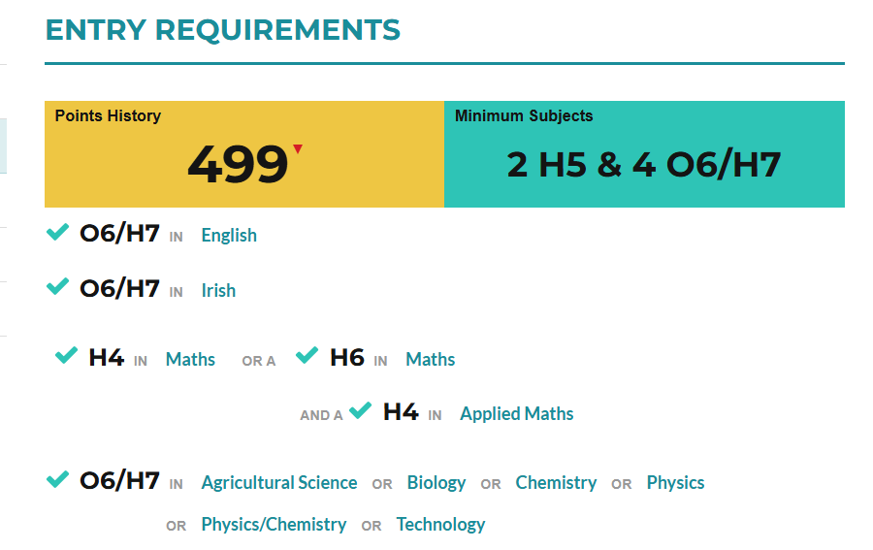
Engineering in UCC

Slide 20
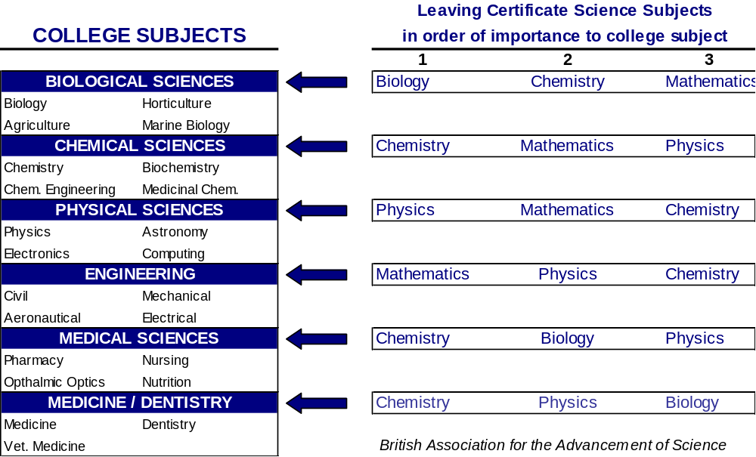
Appliance of Science

Slide 21
Entry Requirements Info
Course Entry Requirements can be accessed:
  In the college’s prospectuses
  On the college’s websites
  www.qualifax.ie – Subject Requirements
  Careers portal

Slide 22
What if we don’t know what we want to do?
We need to try to keep as many options open as we can
Care must be taken as the choices of subjects made now may determine 3rd level and career options in 2 years time.

Slide 23
General Advice
If a student is not really sure what he/she wants to do in the future:
Pick a broad range of subjects in order to keep options open
Many students will change their minds about their future a number of times in the next 2 years
E.g.
  one language
  one science
  What you like
  What your good at.
  Maybe a business subject
  An Applied science
This combination would allow access into a broad range of courses/careers.

Slide 24
A little background
Leaving Certificate 2 year programme.
Usually a maximum of 7 subjects are taken for the Leaving Certificate.(An extra (8th) subject?)
For points purposes best 6 subjects are counted.
All subjects are of equal importance, with the exception of HL Maths
    However 25 additional points will be awarded to students receiving a H6 or better in higher level mathematics
Subject Levels
  Higher and Ordinary level → all subjects.
  Foundation level →Mathematics & Irish.

Slide 25

How many subjects
Student normally have to study
  English
  Irish
  Maths
Student will study 4 other optional subjects which they will select from a possible 19 subjects
One needs to be careful when selecting one’s subjects as it may affect future educational progression
Note if one is exempt from Irish the school is not in a position to offer them an additional subject at the timetabled time,

Slide 26

Look at the options
Key Questions
What subjects are on offer?
What is the subject about
If I’m interested in a particular course/career area, what subjects are essential? (Course Entry Requirements)
Back to example of Nursing course requirement to have science subject

Slide 27
Optional Subjects
BUSINESS
Business
Accountancy
Economics
SCIENCE
Biology
Physics
Chemistry
Agricultural Science
LANGUAGES
French
German
Spanish
APPLIED SCIENCES
Home Economics
Construction Studies
Engineering
Design and Communication Graphics
Applied Maths
SOCIAL STUDIES
History
Geography
Music
Art
Information about LC subjects can be found on the college website: www.crescentsj.ie , www.carersportal.ie and the NCCA website: www.ncca.ie
Notes:
History. This year is the first time students will be examined in the new curriculum. The balance of the course has moved away from a predominant political emphasis, to encompass both social and cultural history. The identification of evidence and primary sources is central to studying history. Students can now secure up to 20% of the overall marks by pre-submitting a research paper on a selected topic, from a range set out by the State Examinations Commission. Essay writing is central to the programme. Students have to present three essays in their Higher Leaving Certificate paper, plus a documents question. Ordinary level students should benefit from the opportunity to prepare a research question under the revised curriculum.
Geography. This subject studies the interrelationship between human activity and the physical environment. It is an extremely wide curriculum, with students having the opportunity to undertake a geographic investigation, which is allocated 20% of the overall marks in the final examination, and is pre-submitted by the end of April in the year of the students leaving certificate. For both Science and Pharmacy at TCD, geography is accepted as a science subject for entry requirements.
Continental Languages. The three main elements of the study of modern languages are comprehension, oral and written presentation. Be mindful of the Aural and Oral requirements. There is a strong emphasis now is on the ability to comprehend and converse in the language studied, and this is reflected in the fact, that a third of the final marks awarded, are for Aural and Oral work. Studying a continental language today requires you to culturally immerse yourself in the spoken, written world of its users.
Applied Math’s. A very suitable subject for the student taking higher-level Math’s and Physics.
Physics. Physics has a strong Maths element and requires the learning off of many formulae. It develops students understanding of many of the ordinary things that surround us such as heat, light, electricity and magnetism. Students must maintain a laboratory book, as there are twenty-seven mandatory experiments, of which four are offered on the leaving certificate paper, with three to be presented.
Chemistry Students taking Chemistry, have to learn off the chemical components of a series of prescribed experiments. They will be required to present the elements of four such experiments in their examination. Again, students studying chemistry, develop an understanding of key elements of the world we live in, such as water as well as everything we use wear or consume.
Biology Students studying Biology explore the world of all living things from micro-organisms to humans. As with the other science subjects, students undertake twenty-four mandatory experiments, the details of which they record in their laboratory book. It is often perceived as an easier subject than Physics and chemistry, but this is not so, as shown by the high failure rates at ordinary level.
Social & Scientific. A combination of Cooking, Home Economics some Biology and a bit of Business. A very interesting subject, but not the easy honours that some imagine. Twenty percent of the marks are awarded for a course work journal, done within normal class time, and pre-submitted in October of 6th year, prior to the written examination. The study of Food Science is a central part of this subject. Students also have the option of studying one of Social Studies, Textiles or Home Design.

Slide 28

Looking at the fields
Key Questions
If not essential, what subjects maybe useful/helpful for this course/career area?
What subjects do I like? (motivation) (not the teacher or friends)
What subjects am I relatively good at? (Past performances, Aptitude test results)
How are the subjects assessed (is there a project)
Back to example of Apprentice Electrician while there is no actual subject required what would be useful? Physics/ Construction Studies

Slide 29
The option process
Student select their top 8 choices
From the data
  Number of classes are decided based on Demand, Teachers and School resources such as 4 biology classes 1 DCG class
  A computer programme formulated 4 option lines which maximise student preferences

Slide 30
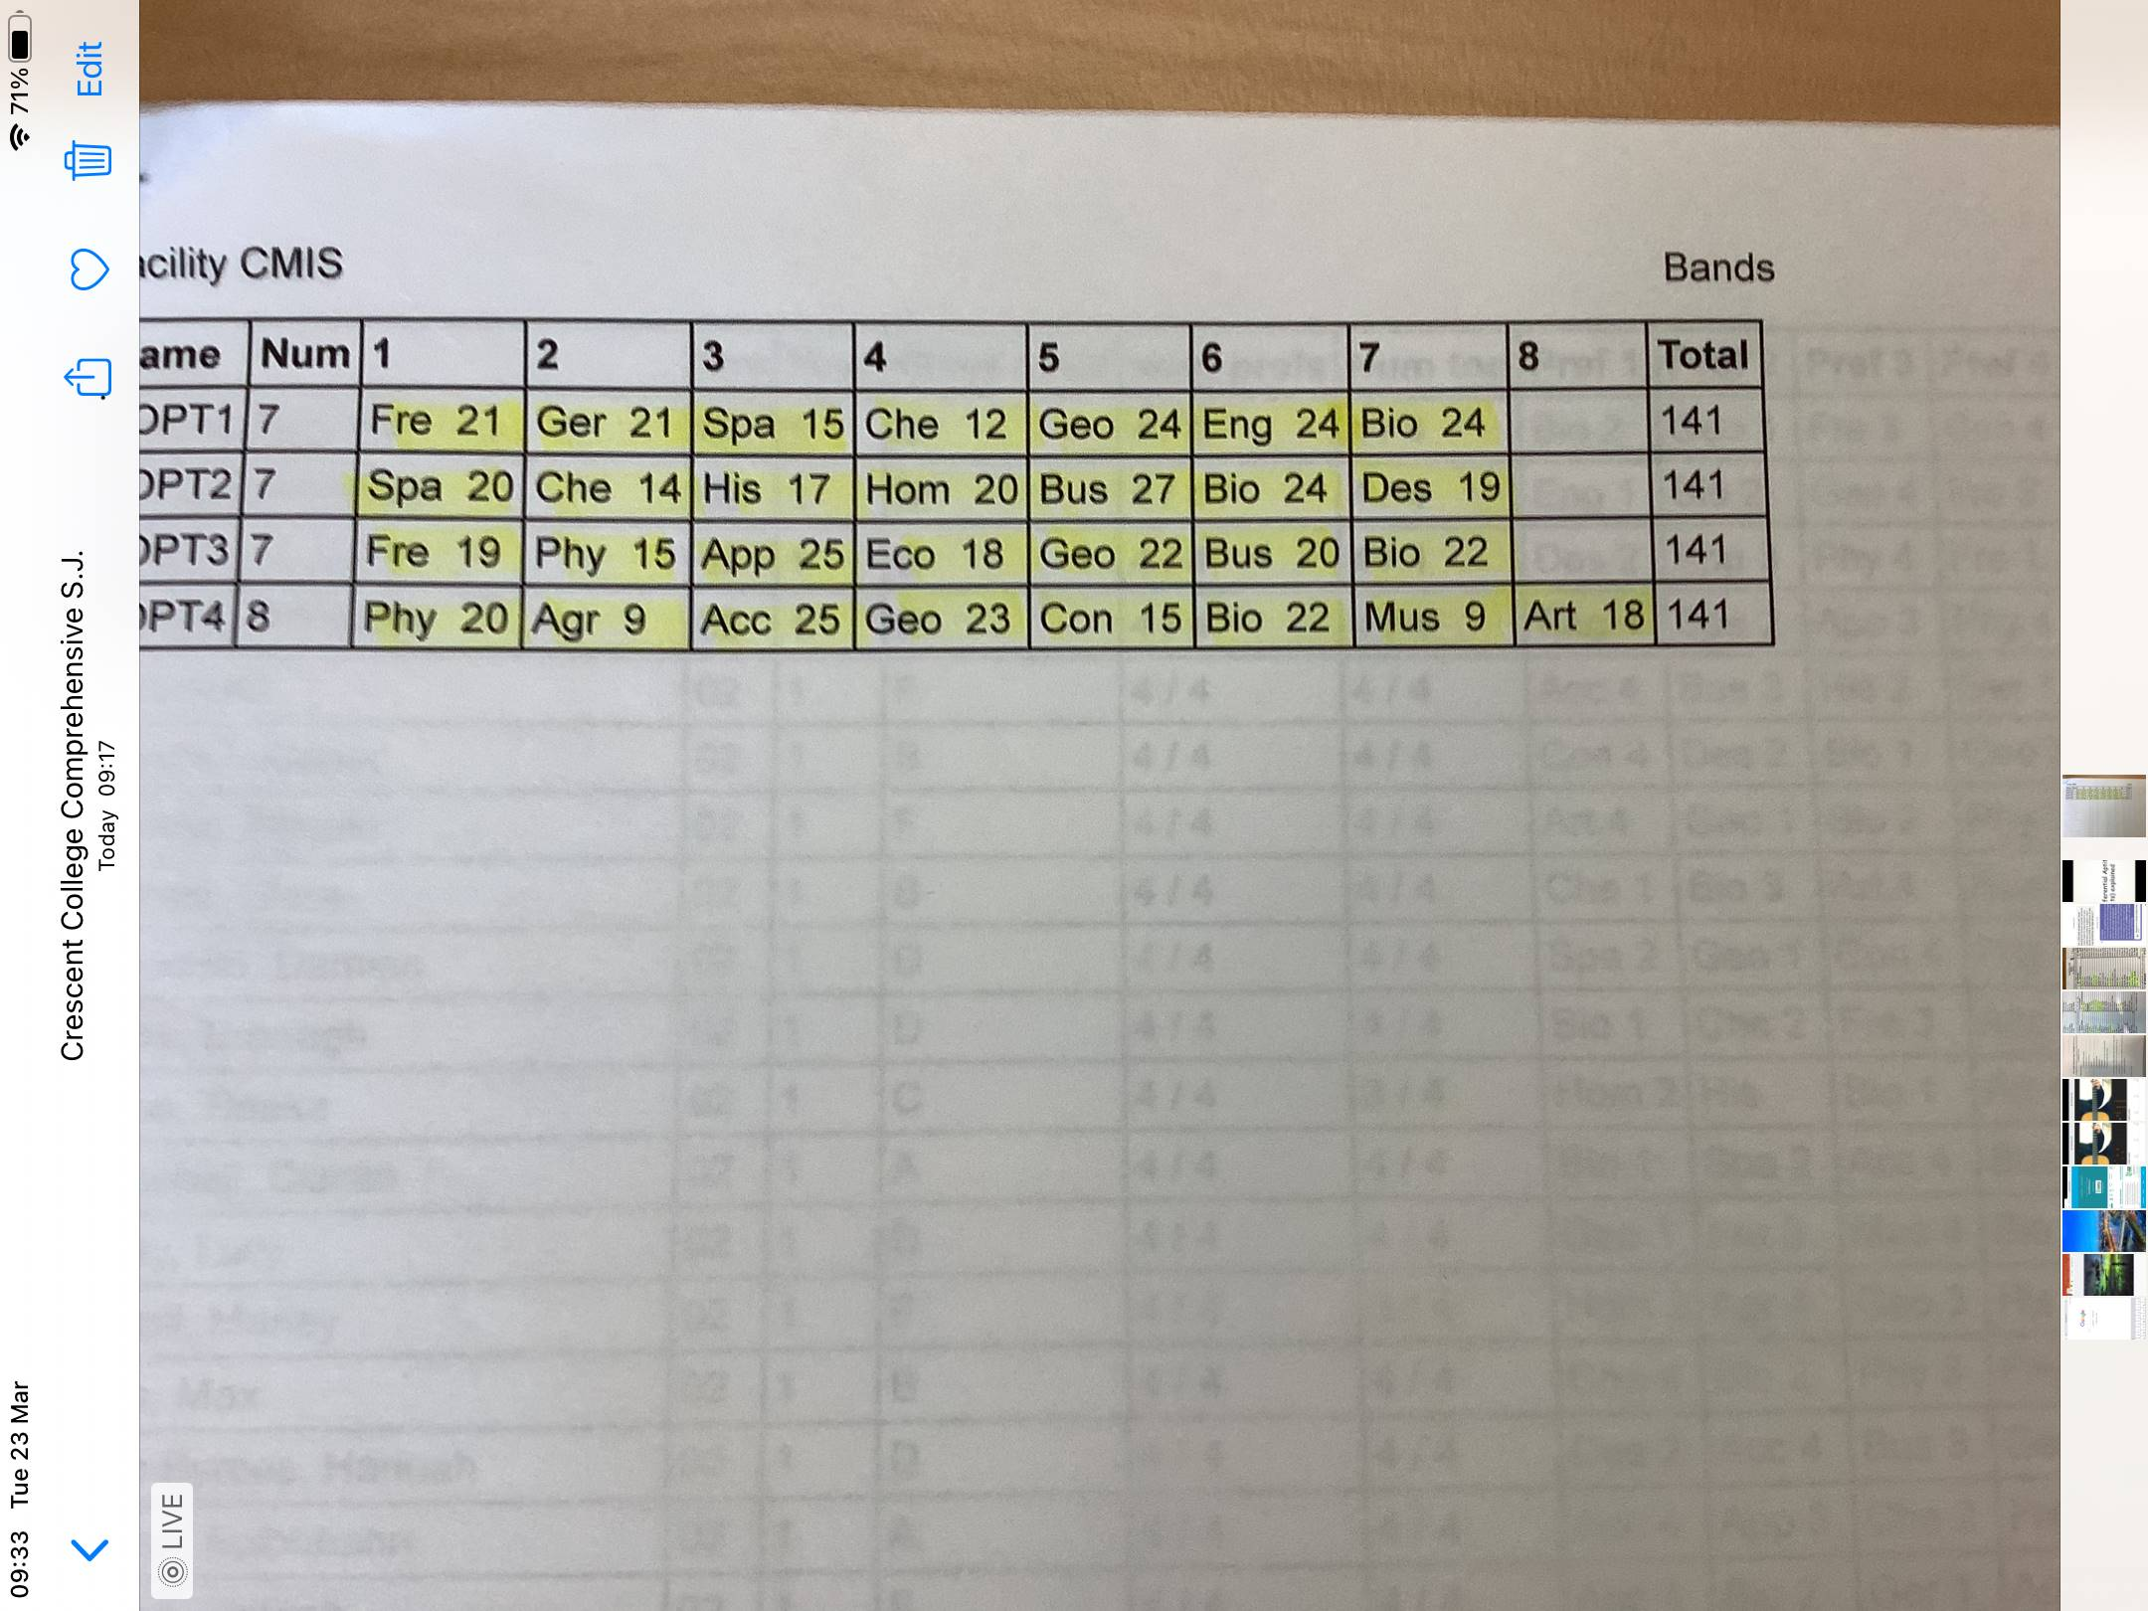
Note
It not always possible to give students their first 4 subject options
This can happen for 2 reasons
Subject being oversubscribed
Subject clashing
For example on line 3 Applied Maths clashes with Economics

Slide 31
Important Points
No subjects are gender specific.
Every student is unique (interests, abilities and aptitudes), hence they should choose subjects based on these and not current friendships, or the opinions of others.
Not advisable to select subject based on a Teacher.
Practical Stance
Students should be aware of balancing subjects which help maximise points vs. subjects which may be of benefit to them in the future.

Slide 32
Timetable of Events
March 24th – Subject choice information evening.
March 25th - Online forms for subject choice will be distributed on Compass to the Students
March – Class presentations continue.
April 2nd at 11am Deadline for online submission of application forms for subject preferences.
May – Generation of classes begins.
Notes:
After April 1st deadline there is no guarantee that students will get their selection of subjects.

Slide 33
www.careersportal.ie
Click on - School student
- Leaving Cert
- Leaving Cert subjects - (Each
subject explained in great detail)

Slide 34
Course information
WWW.qualifax.ie
Listing of all college courses and their requirements

Slide 35

The Leaving Cert can be Stressful
Planning and Research can help Reduce Stress

Slide 36
Thank you for coming

